Slide 1
The History of wireless communication
Jesse russell

Slide 2
Summary of wireless communication
Wireless communication is not a new concept.
Types of wireless communication include:
Wifi
Bluetooth
NFC (Near Field Communication)/RFID (Radio Frequency Identification)
Cellular data
Infrared
Notes:
Wireless communication is not a new concept. Most if not all of the students in this room have been around wireless technology our entire lives. It was around long before most of us were born, and it will be here long after we are all gone. There are multiple types of wireless communication, including WiFi, Bluetooth, NFC (which is used for wireless charging and data transfer), Cellular data, infrared, and RFID (used for entry to secure areas.)

Slide 3

Modes of wireless communication
Radio
Free Space Optical (FSO)
Sonic
Electromagnetic Induction
Notes:
Radio – Modulates properties of electro magnetic waves that travel through space, FSO – Uses light beams in open air, or free space to transmit data, sonic – short range communication using sound, electromagnetic induction – has a short range and minimal power and uses the electro magnetic field tot transmit data.

Slide 4
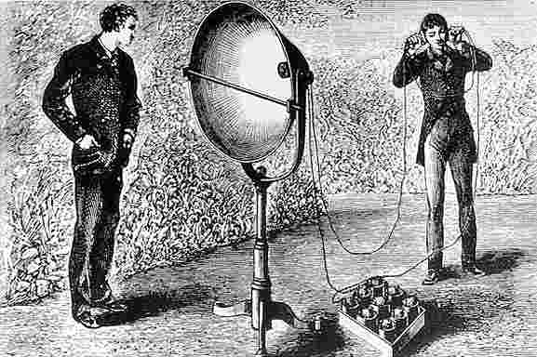
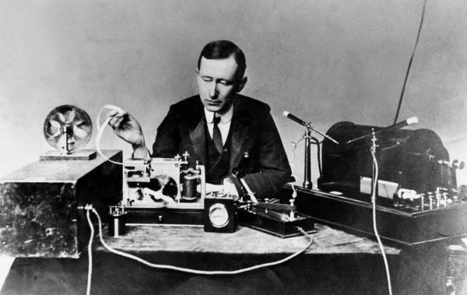
Early Wireless communication
Photophone (1880)
Radio Wave Telegraph System (1894)
Notes:
The earliest use of wireless communication was in 1880, when Alexander Graham Bell and Charles Sumner Tainter invented the photophone. This used light waves to communicate, though there was no electricity, so this invention was not practical. It required good weather conditions and sunlight. It also required direct line of sight between the transmitter and receiver. This concept, however, was adapted decades later into fiber optic communication. Next, is the telegraph system invented by Guglielmo Marconi. This used radio waves, which were discovered in 1888, by Heinrich Hertz. Marconi was awared the Nobel prize for physics in 1909 due to his contributions in wireless technologies.

Slide 5
Early wireless communication
Radar (1900)
Frequency Modulation (FM) (1902)
Amplified Modulation (AM) (1914)
First BBC Broadcast (1922)
Mobile Telephone (1924)
Notes:
In 1900, Tesla obtained the first patents on radio. Tesla is also the first person to use radio waves to locate items, this is what we known as radar. In 1902, Cornelius D. Ehret filed patents on one transmission of coded signals, known as Frequency modulation (FM). In 1914, Carl R Englund developed the first equation for amplified modulation (AM). In 1922, the BBC broadcasted their first program. In 1924, The Bell Telephone Company introduced the mobile telephone, which her integrated into NYC police cars.

Slide 6
Median years of wireless communication
Radar Jamming (1944)
Commercial Mobile Telephone (1946)
Doppler Radar (1949)
Satellite Communications (1955)
Transistor Radio (1955)
Notes:
In 1944, Radio research labs developed the first radar countermeasures, known as jamming. This worked from the range of 25mHz, to 6 gHz. While the mobile telephone was introduced in 1924, it was not commercialized until 1946. Even then, it took nearly 4 decades to enter the mainstream market. In 1949, the operations for doppler radar was published by E. J Burlow. Communication using satellite was proposed by John R Pierce in 1955. In the same year, Sony marketed the first transistor radios.

Slide 7
Median years of wireless communication
IEEE (1963)
Digital Radio Relay System (1969)
ARPANET (1969)
Cell Phone System (1978)
Broadband Notch Antenna (1989)
World Wide Web (1990)
Notes:
In 1963, the Institute of electrical and electronic engineers (IEEE) was formed. In Japan, in 1969, the first Digital Radio Relay System was implemented, using a 2gHz frequency. In the same year, ARPANET was introduced. ARPANET is the very early version of what we know as the internet. In 1978, AT&T Bell Labs began testing a mobile network based on cells, which we now know as a cellular network. The broadband notch antenna was invented in 1989, by F. Laleari. And finally, The wonderful invention of the world wide web was brought to life in 1990.

Slide 8
wireless communication today - wifi
Runs on either 2.4 GHz or 5 GHz.
Used to connect wirelessly to a network.
Security protocols: Wired Equivalent Protection (WEP), WiFi Protected Access (WPA), Wifi Protected Access Version 2 (WPA2).

Slide 9
Wireless communication today - Bluetooth
Uses 2.4 MHz band
Not very secure
Used for wireless keyboards, headphones, mice, etc.
Types: 1 (100m), 2 (10m), 3 (1m), 4 (0.5m).

Slide 10
Wireless communication today – NFC/RFID
Uses 2 devices brought within 4cm together to transmit data.
Used in Apple/Samsung/Android pay, tap credit cards, smart cards, token readers, smartphones, etc.
Also used for token games such as Skylanders, Disney Infinity, Amiibo, etc.

Slide 11
Wireless communication today - infrared
Uses electromagnetic radiation.
Used for TV remotes, thermal cameras, game controllers, etc.
Line of sight required.

